Slide 1
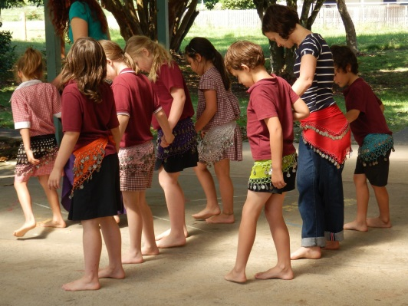
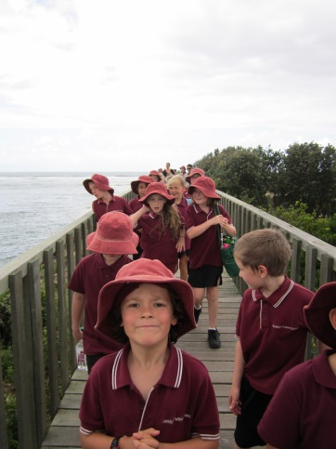
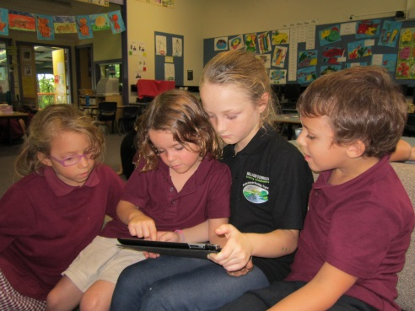
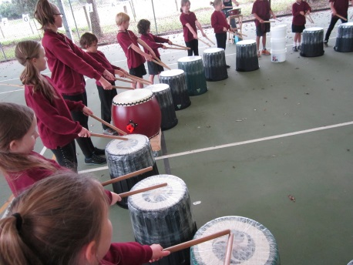
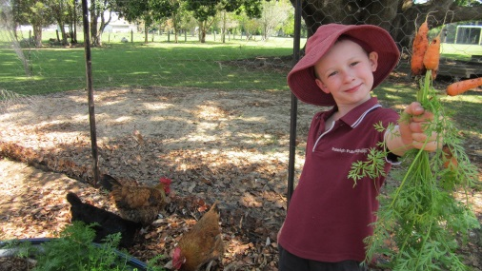
Raleigh Public School
Please call the office or visit our website for more information.
Raleigh Believes in Me!
Kindergarten Transition Days
will be held for students starting kindergarten next year at Raleigh Public School on :
Tuesday 4th November: 10:20am-11:20pm (Literacy)
- Thursday 27th November: 1:30-2:45pm (Music)
Wednesday 3rd December: 12:00pm-1:00pm (Art)
12 North Street, RALEIGH NSW, 2454 T: (02) 66554228
For further details and a program outline visit www.raleigh-p.schools.nsw.edu.au

